Slide 1
Tables

Slide 2
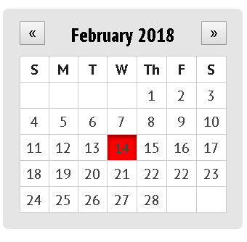
A Calendar

Slide 3
Code
<!doctype html>
<html>
<head>
<meta charset="utf-8">
<link href='http://fonts.googleapis.com/css?family=PT+Sans:400,700,400italic,700italic' rel='stylesheet' type='text/css'>
<link href='http://fonts.googleapis.com/css?family=PT+Sans+Narrow:400,700' rel='stylesheet' type='text/css'>
<link rel="stylesheet" href="calendar.css">
</head>
<body>
<div>
<header>
<button>«</button>
<h2>February 2018</h2>
<button>»</button>
</header>
<table>
<tr> <td>S</td> <td>M</td> <td>T</td> <td>W</td> <td>Th</td> <td>F</td> <td>S</td> </tr> <tr> <td></td>
<td></td> <td></td> <td></td> <td>1</td> <td>2</td> <td>3</td> </tr>
<tr> <td>4</td> <td>5</td> <td>6</td> <td>7</td> <td>8</td> <td>9</td> <td>10</td>
</tr> <tr> <td>11</td> <td>12</td> <td>13</td>
<td class ="selected">14</td>
<td >15</td> <td>16</td>
<td>17</td> </tr> <tr>
<td>18</td> <td>19</td>
<td>20</td> <td>21</td> <td>22</td> <td>22</td> <td>23</td> </tr> <tr> <td>24</td> <td>25</td> <td>26</td> <td>27</td> <td>28</td>
<td></td> <td></td> </tr></table></div>
</body>
</html>

Slide 4
Code
body {line-height: 1; margin: 50px;}
div { background: rgba(0, 0, 0, .1);
border-radius: 5px; box-sizing: border-box;
padding: 15px; width: 220px; }
header {overflow: clear;position: relative;}
h2 {font-family: 'PT Sans Narrow', sans-serif;
font-size: 18px;font-weight: 700;
margin: 0 0 10px;text-align: center;}
button {position: absolute;top: -4px; }
button:first-child {left: 0; }
button:last-child {right: 0; }
table {background: #fff; border-collapse: collapse;
color: #222; font-family: 'PT Sans', sans-serif;
font-size: 13px; width: 100%; }
td {border: 1px solid #ccc; color: #444;line-height: 22px; text-align: center;}
tr:first-child td {color: #222; font-weight: 700; }
.selected {background: #ff0000; border: 0;box-shadow: 0 2px 6px rgba(0, 0, 0, .5) inset; }

